Slide 1
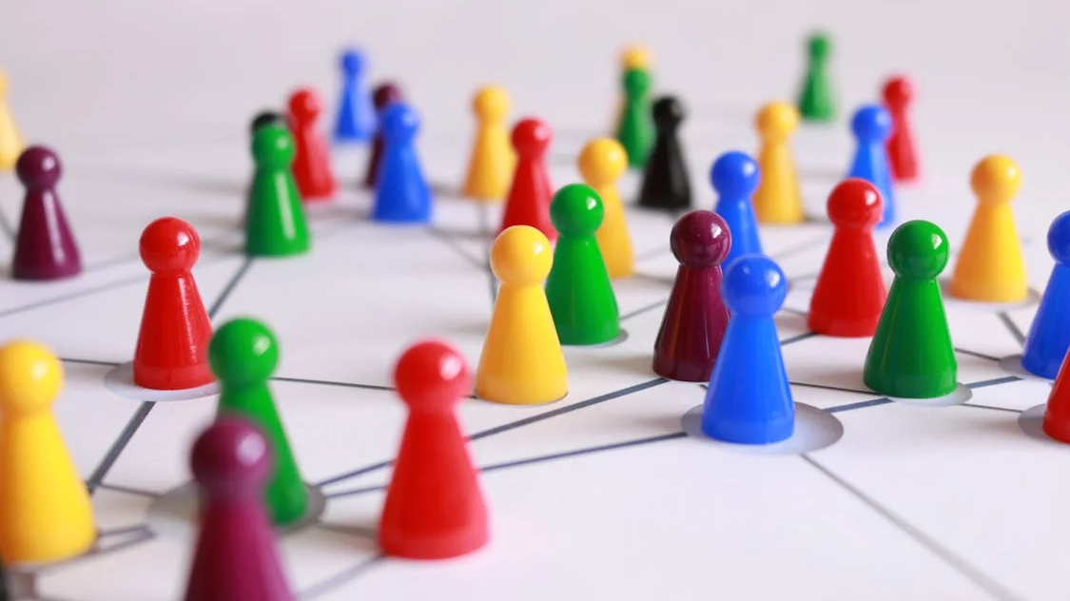
Socializations, Social Groups, Networks, and the Internet

Slide 2
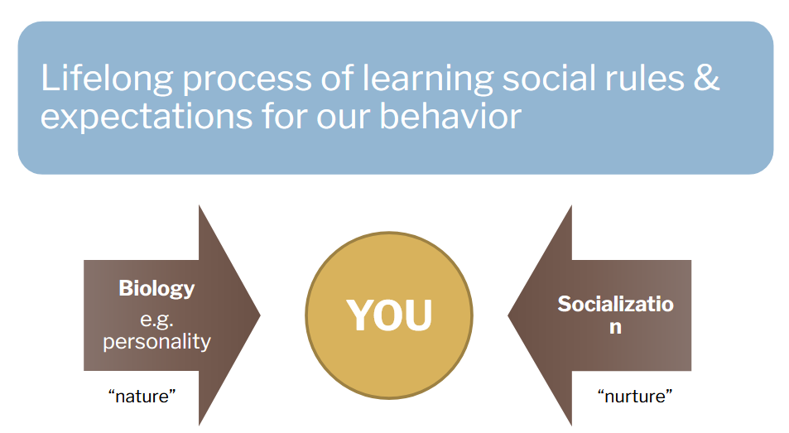
Socialization and self-formation

Slide 3
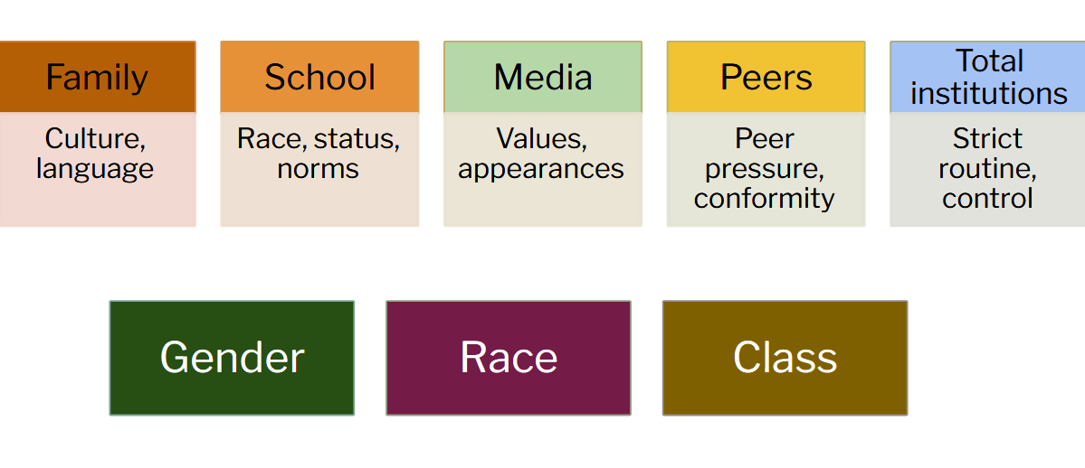
Agents of socialization

Slide 4
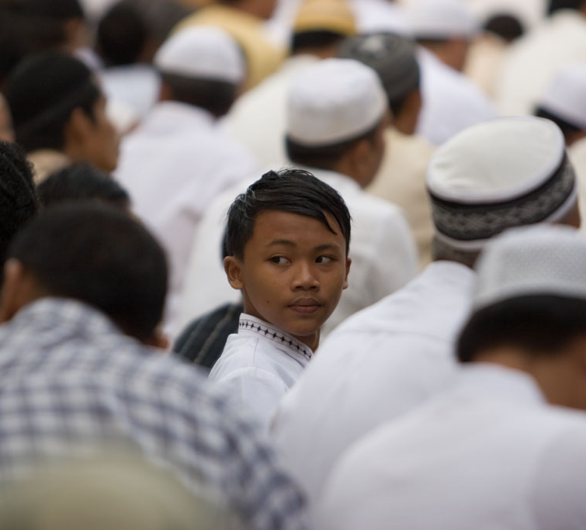
INDIVIDUAL AGENCY
AND SOCIAL
STRUCTURE

Slide 5
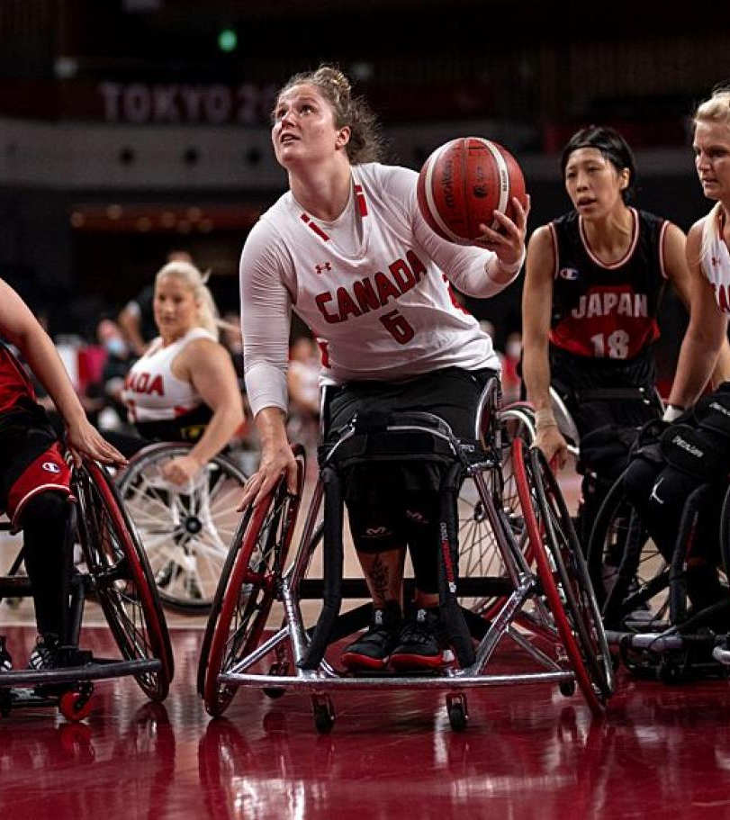
Agency
Agency: our capacity to act given the structural rules and resources that impact our behaviors. Agency refers to the choices that individuals make and the actions we ultimately take.

Slide 6

Reflexivity

Slide 7
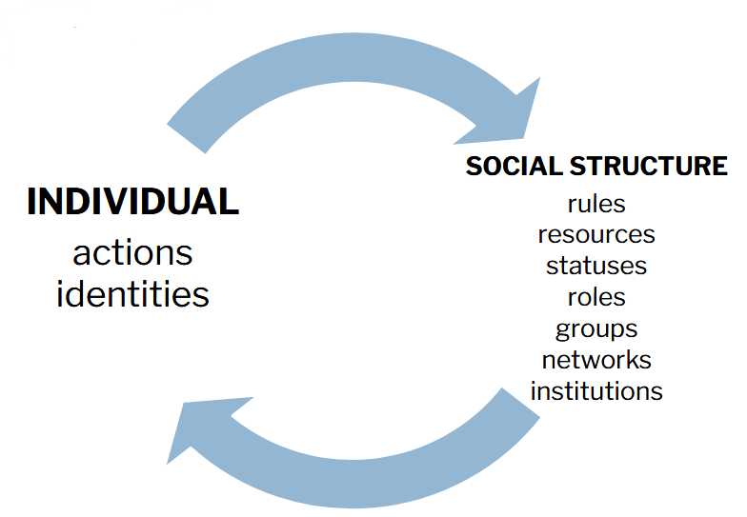
Individual Agency and Social Structure

Slide 8
Overview
What are social groups and what sorts of groups exist?
What are social networks and how do they affect us in the digital age?
What are organizations and how do they differentiate themselves from broader society?
What is social capital?

Slide 9
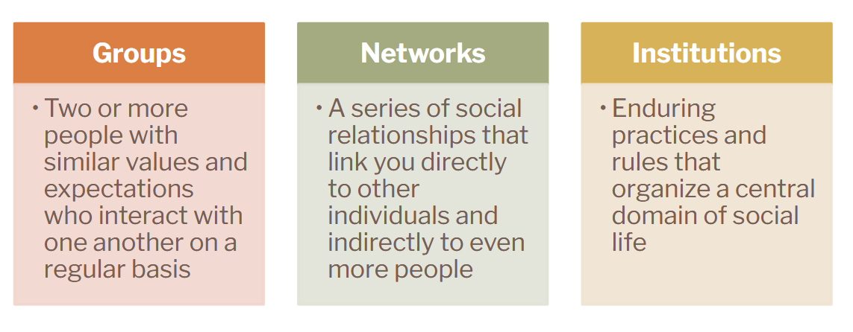
Social Groups, Networks, & Institutions

Slide 10

Social Groups
Groups are the building blocks of society
We don’t need to know anything about the characteristics of group members to make certain predictions about how the group will act

Slide 11
Reading Questions
What is the intravidual? How does this relate to the nature of our digital engagement in daily life?
What is the impact of this change?
What is difference between “embedded” premodern groups, “affiliation” based modern groups, and “ungroups” of the digital age?
Does the reading’s arguments align with your own experiences? How so, or how does it not?

Slide 12
Dyads
Husband
Wife
Groups of two
Most intimate of all groups
Requires an inherent sense of “symmetry”
Parent
Child
Friend
Friend

Slide 13
Triads
Dad
Mom
Group of 3
Group will still exist if one member leaves
Third parties as mediators: help keep the group together
Third parties as divide et impera: try to drive the dyad apart
Third parties as tertius gaudens: Benefit from disagreement of dyad
Child
Friend
Friend
Friend

Slide 14
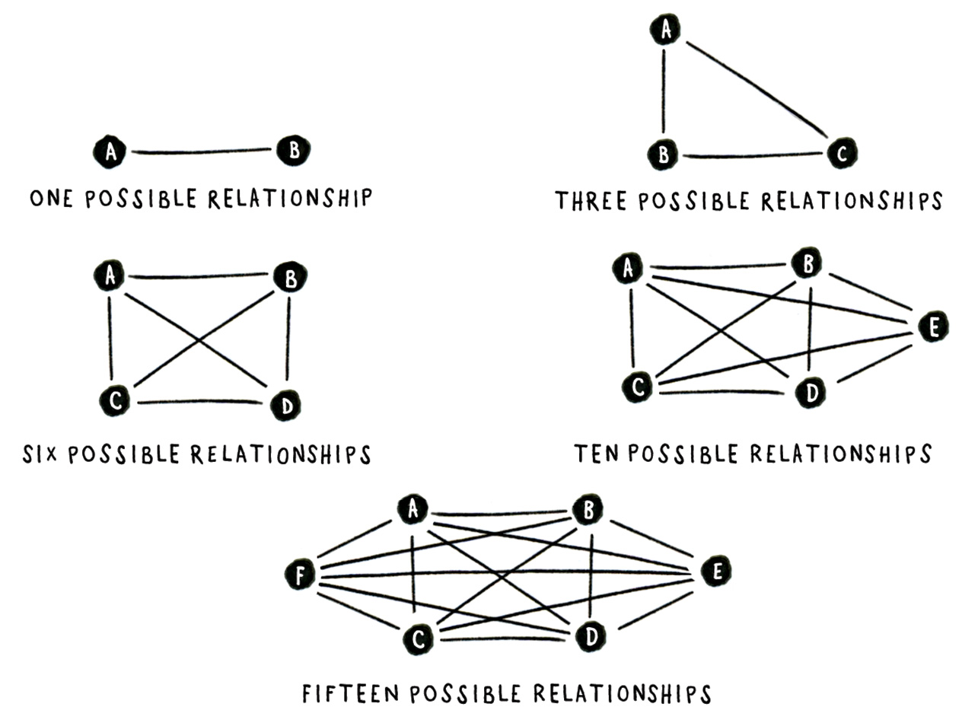
Larger Groups
The number of potential relationships rapidly as we add in more people to the group.
In any group of "N" people, the number of possible relationships (R) is [ N x (N-1) / 2 ].
How many potential relationships are there in this class?

Slide 15
Primary vs. Secondary Groups
Primary Groups
Example: Family
Made up of few members
Key agents of socialization
Members are noninterchangeable
Relationships are enduring
Secondary Groups
Example: University
More impersonal
More instrumental
Membership is contingent
Roles are more important that the individuals who fill them

Slide 16

Primary vs. Secondary Groups
Other than your family or Franklin and Marshall, what is another group that you belong to? Is it primary or secondary?

Slide 17
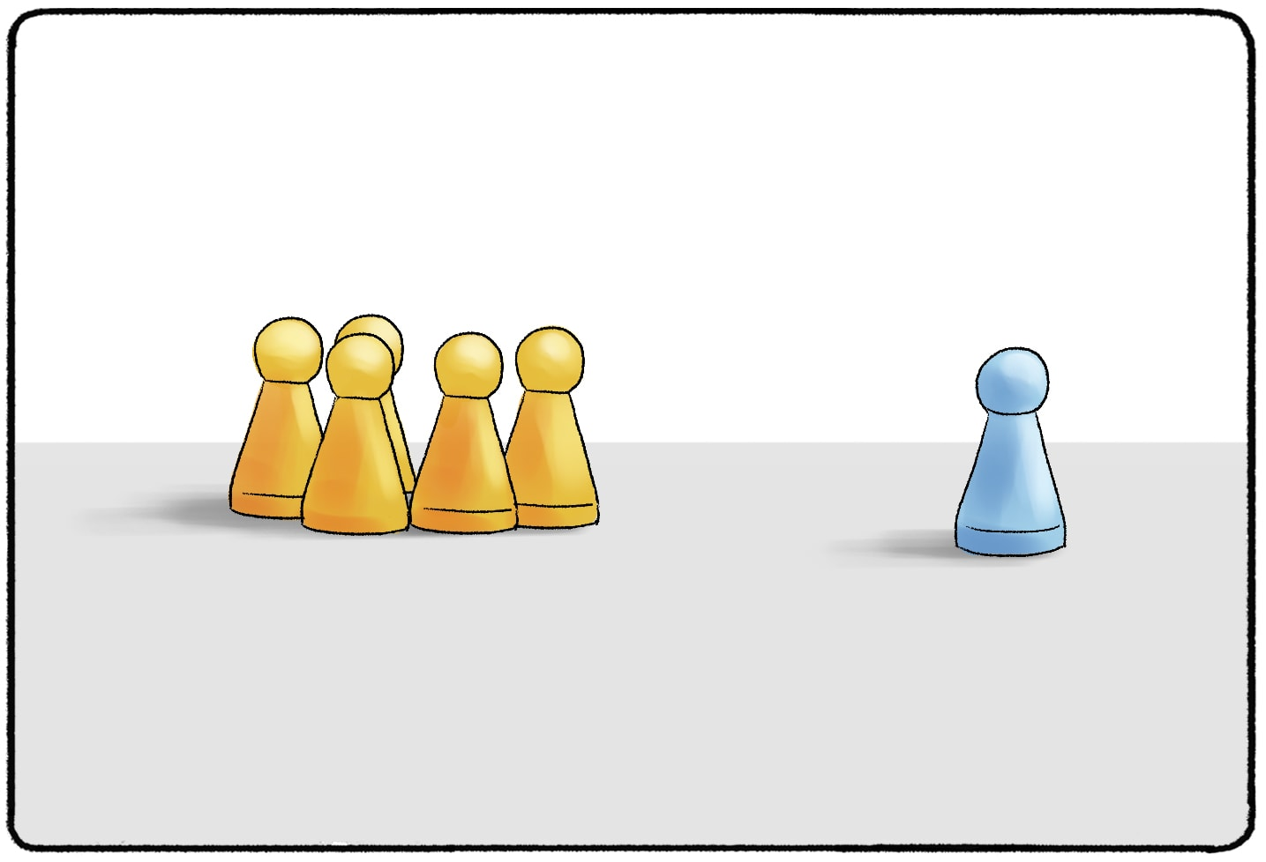
In-Group and Out-group
In-group: The powerful group, usually the majority
Out-group: Stigmatized or less powerful group, usually the minority
Reference Group: Groups that help us understand or make snes of our positions in society

Slide 18
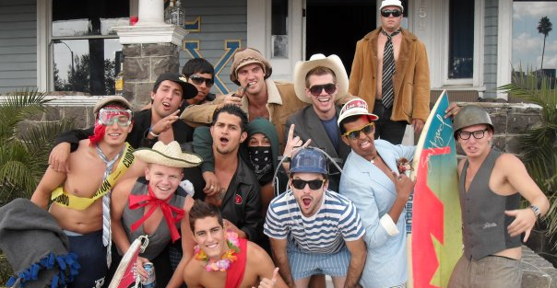
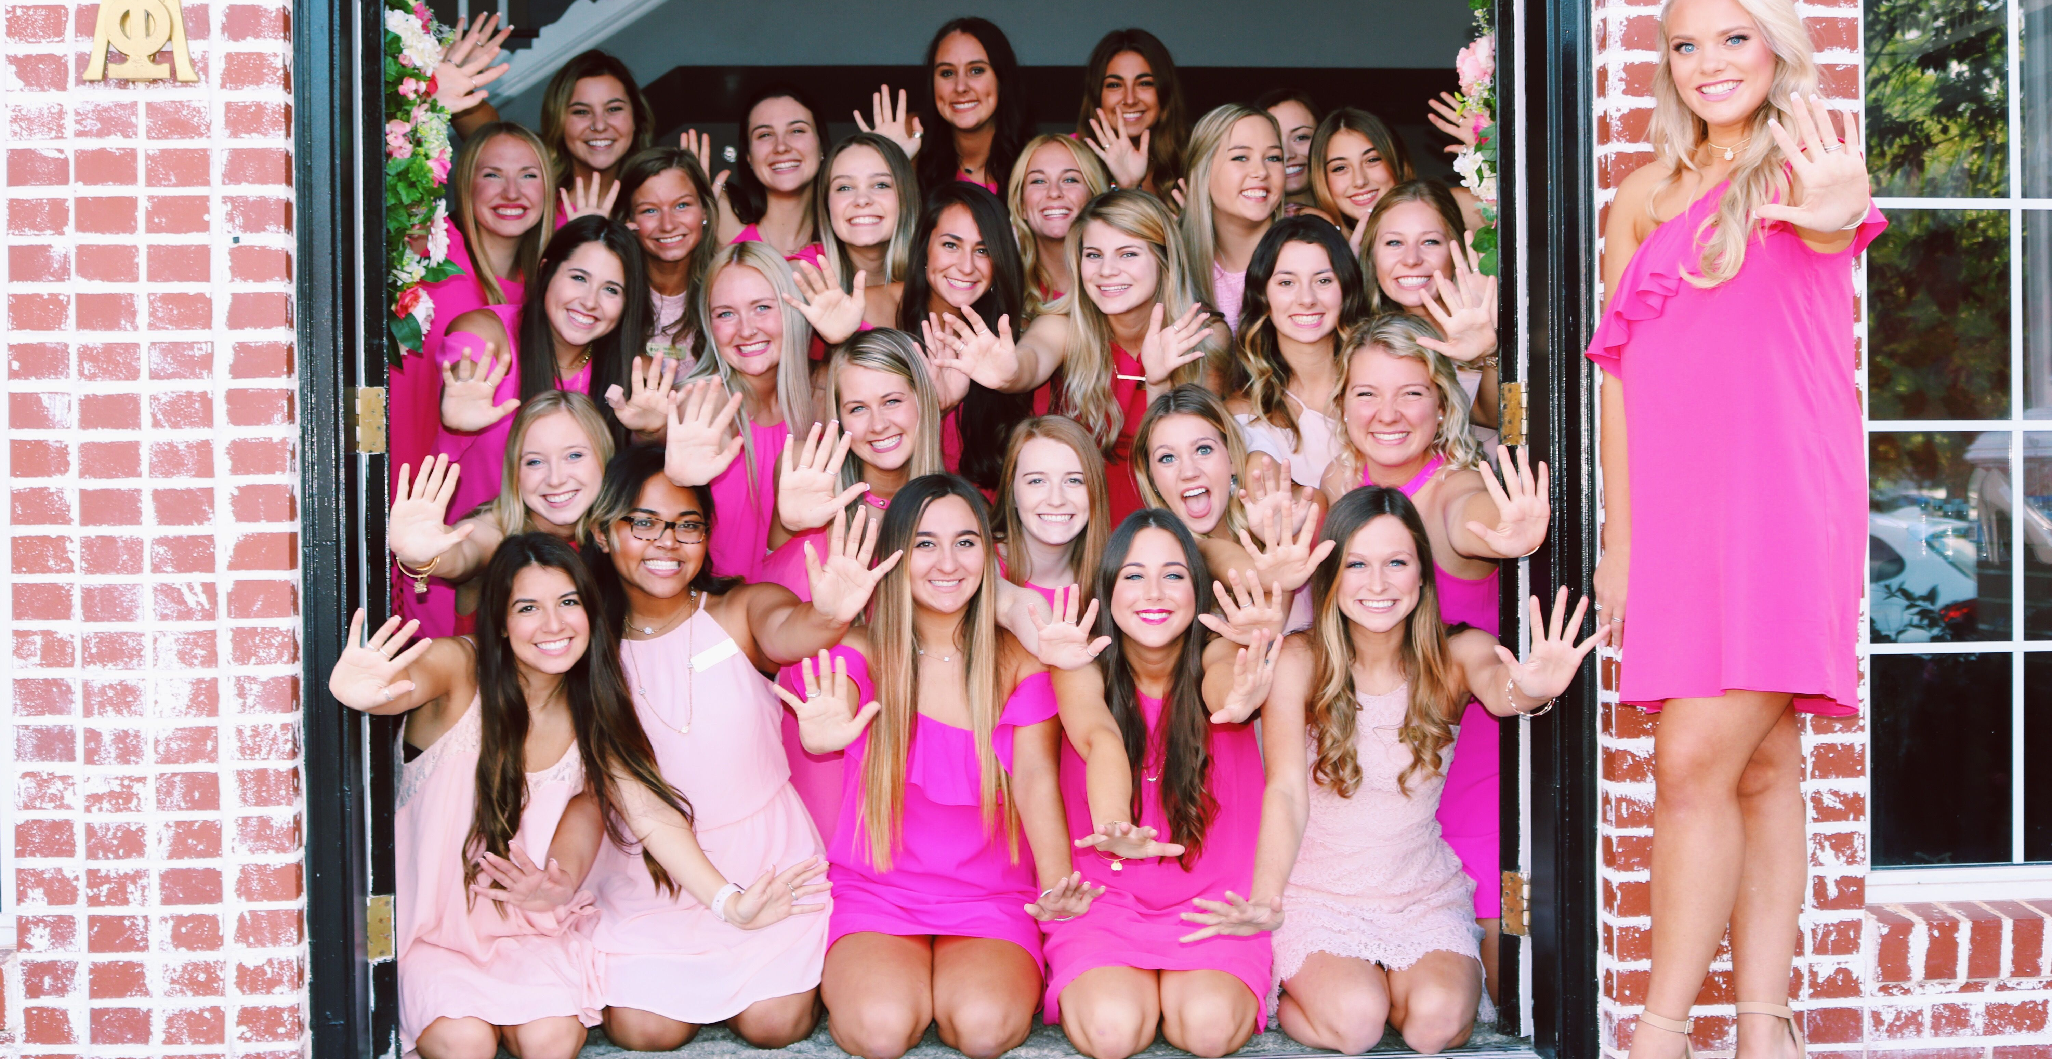
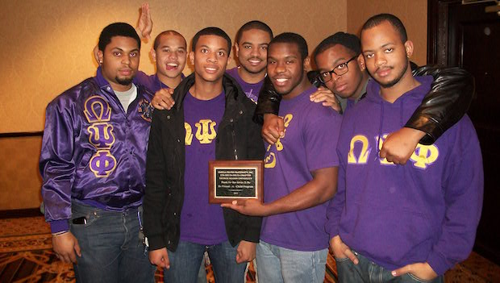
Discussion
Why do college men join fraternities? What structural resources are they hoping to gain and what identities are they hoping to construct through Greek life?
Are the opportunities the same for women in sororities?
How is Greek life racialized?
What about for people who are not in Greek life?

Slide 19

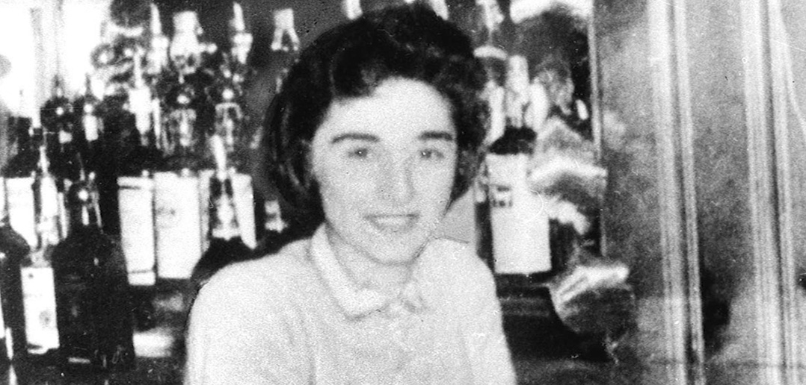
Group Conformity
Bystander effect: When the presence of others discourages an individual from intervening in an emergency.
The murder of Kitty Genovese

Slide 20
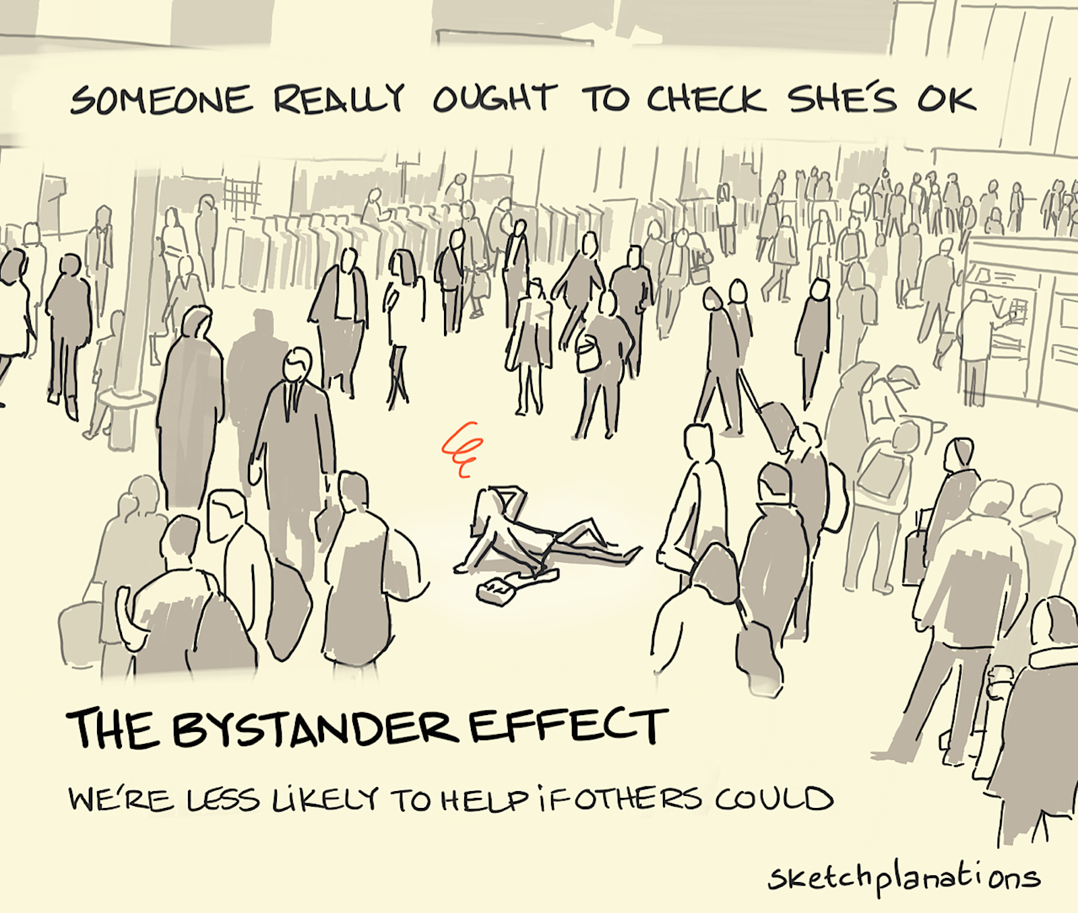
Is the Bystander Effect Real?
Laboratory vs Real-World Setting
2019 anthropological study of CCTV footage by Marie Rosenkrantz Lindegaard’s research team

